Slide 1
AI in Mathematics
Lecture 6
Deep Learning in Mathematics
Bar-Ilan University
Nebius Academy | Stevens Institute of Technology
April 29, 2025

Slide 2
About This Course
1 week: Intro
2 weeks: Classic ML
2 weeks: Deep Learning in Mathematics
3 weeks: Math as an NLP problem (LLMs etc.)
3 weeks: Reinforcement Learning (RL) in Math
1 week: Advanced AI topics
1 week: Project Presentations

Slide 3
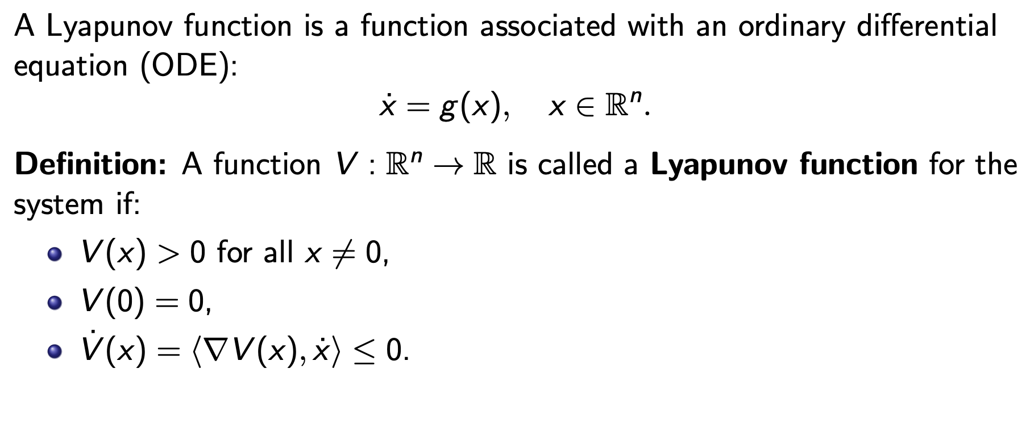
Lyapunov Functions
Why are they important?
Lyapunov function ⇔ Stable system

Slide 4
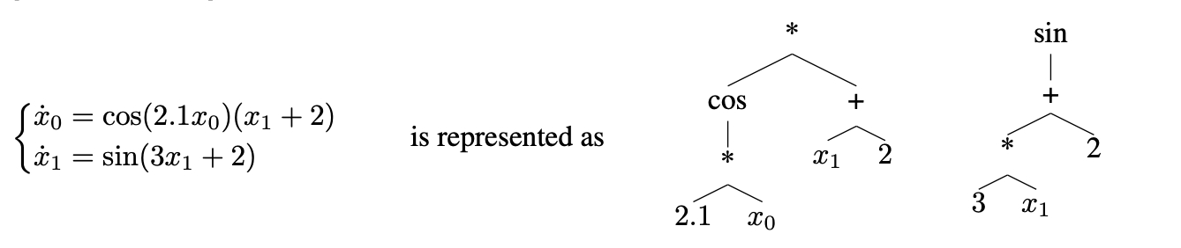
Lyapunov Functions
The problem of predicting Lyapunov function naturally states the question: How to represent functions as features or provide them as an answer?

Slide 5
Lyapunov Functions
Previously our methods depended on fixed size of features and output was either a class or a number
We will need a new functionality to cover such a problem.

Slide 6
Lyapunov functions
We train transformers with 8 layers, 10 attention heads and an embedding dimension of 640 (ablation studies on different model sizes can be found in Appendix C), on batches of 16 examples, using the Adam optimizer [Kingma and Ba, 2014] with a learning rate of 10−4, an initial linear warm-up phase of 10,000 optimization steps, and inverse square root scheduling.

Slide 7
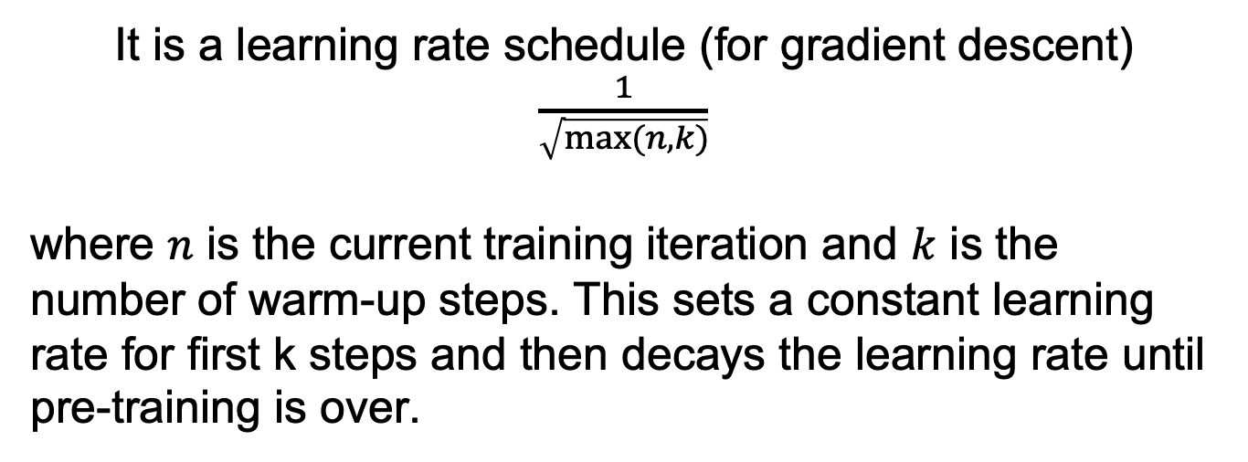
Inverse Square Root Schedule
It is a learning rate schedule (for gradient descent) $\frac{1}{\sqrt{max⁡(n,k)}}$
where $n$ is the current training iteration and $k$ is the number of warm-up steps. This sets a constant learning rate for first k steps and then decays the learning rate until pre-training is over.

Slide 8
Lyapunov functions
We train transformers with 8 layers, 10 attention heads and an embedding dimension of 640 (ablation studies on different model sizes can be found in Appendix C), on batches of 16 examples, using the Adam optimizer [Kingma and Ba, 2014] with a learning rate of 10−4, an initial linear warm-up phase of 10,000 optimization steps, and inverse square root scheduling.

Slide 9
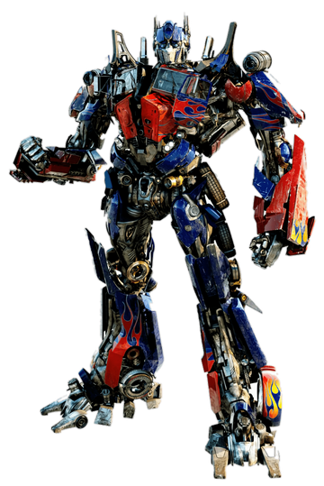
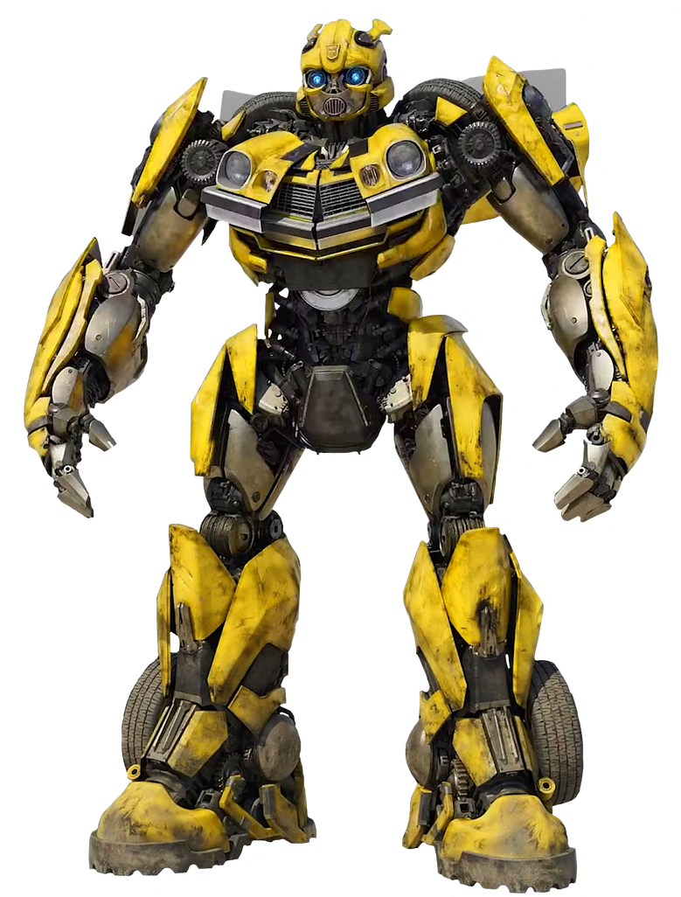

Transformers
Will be next time!

Slide 10
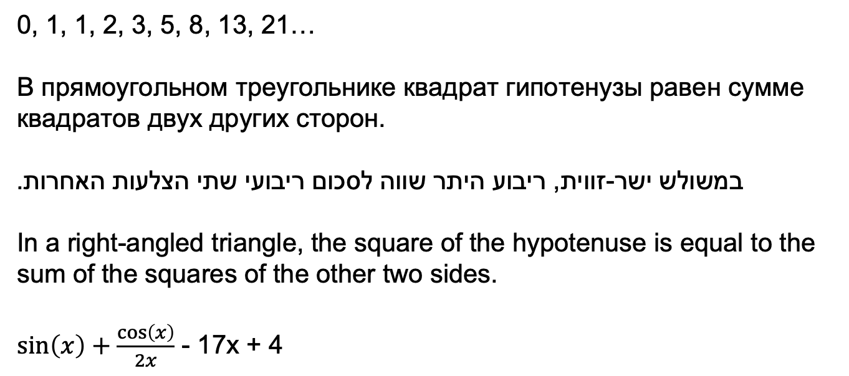
Sequential data
General idea: We want to be able to process sequential data:
0, 1, 1, 2, 3, 5, 8, 13, 21…
В прямоугольном треугольнике квадрат гипотенузы равен сумме квадратов двух других сторон.
במשולש ישר-זווית, ריבוע היתר שווה לסכום ריבועי שתי הצלעות האחרות.
In a right-angled triangle, the square of the hypotenuse is equal to the sum of the squares of the other two sides.
$\sin\left(x\right)+\frac{\cos\left(x\right)}{2x}$ - 17x + 4

Slide 11
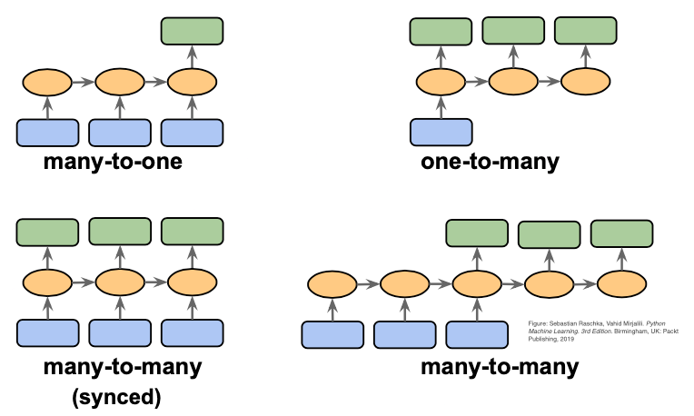
Types of problems

Slide 12
Types of problems

Slide 13
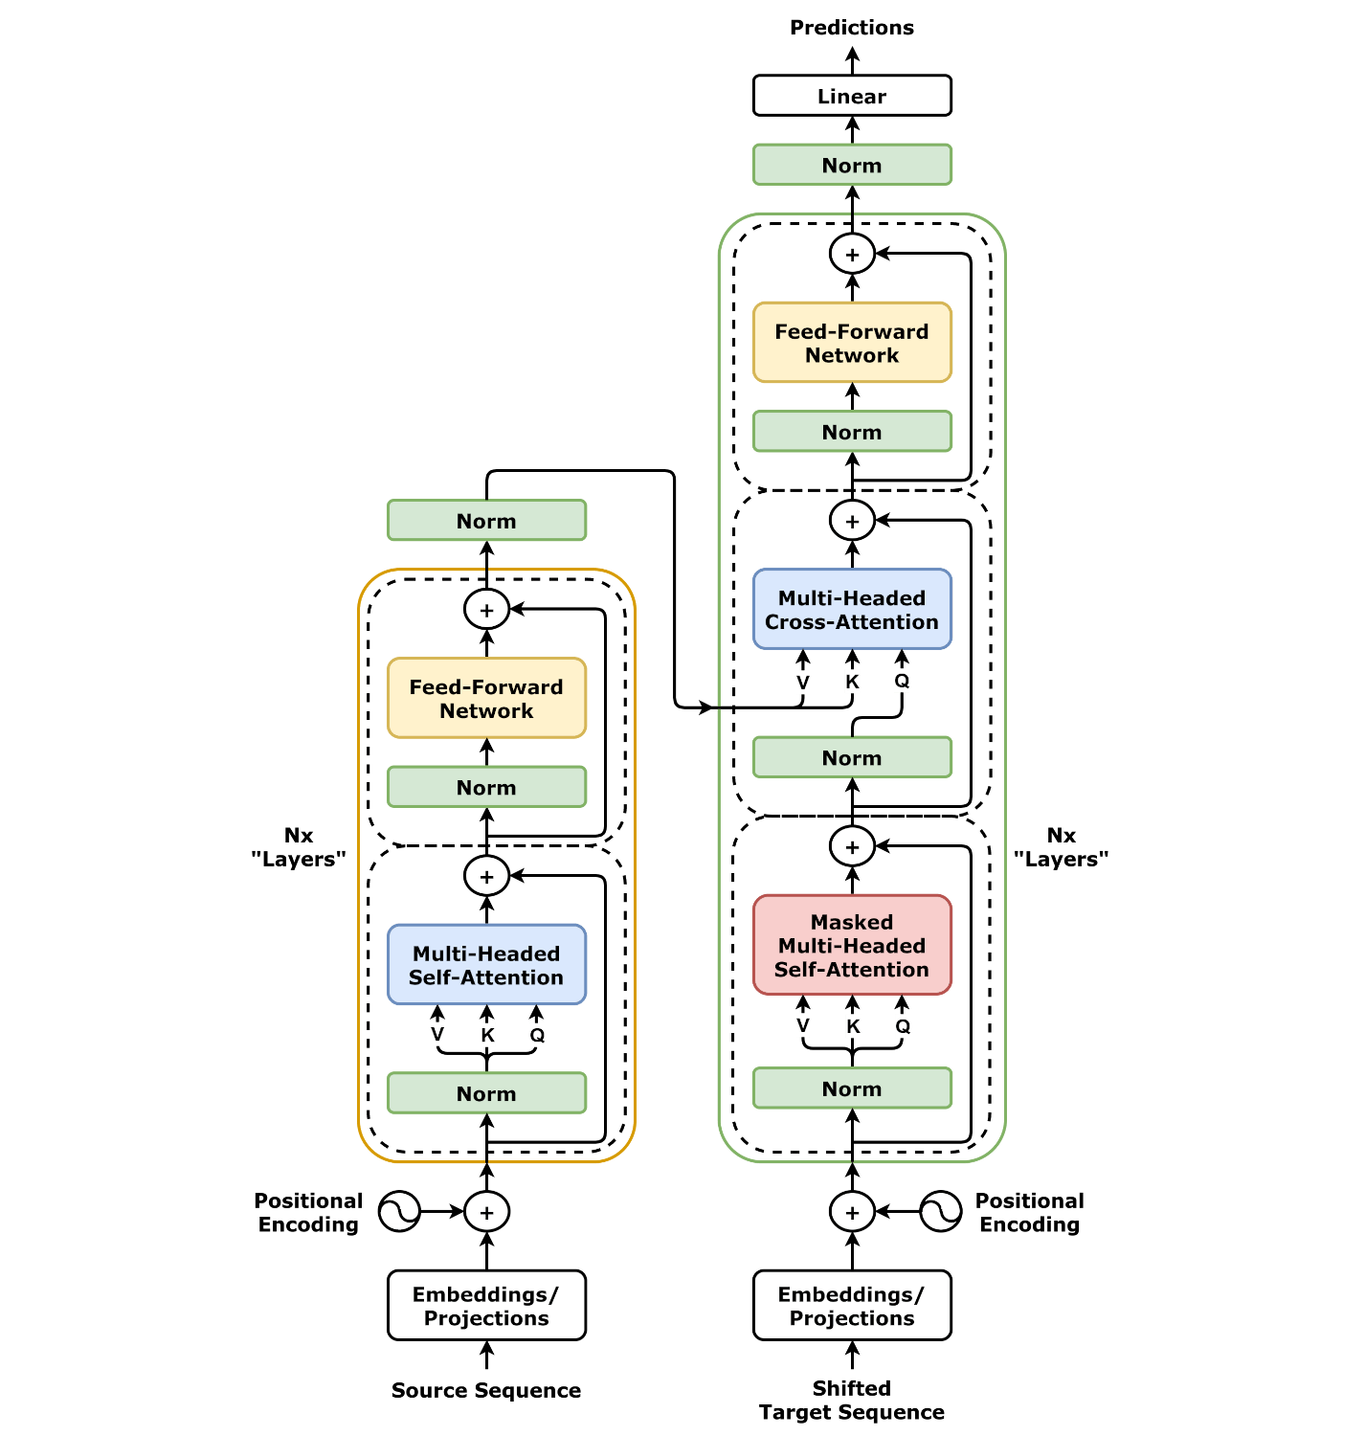
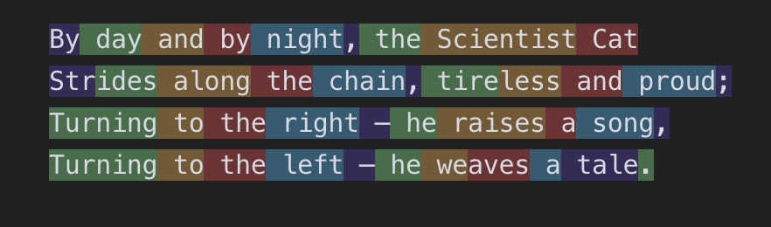
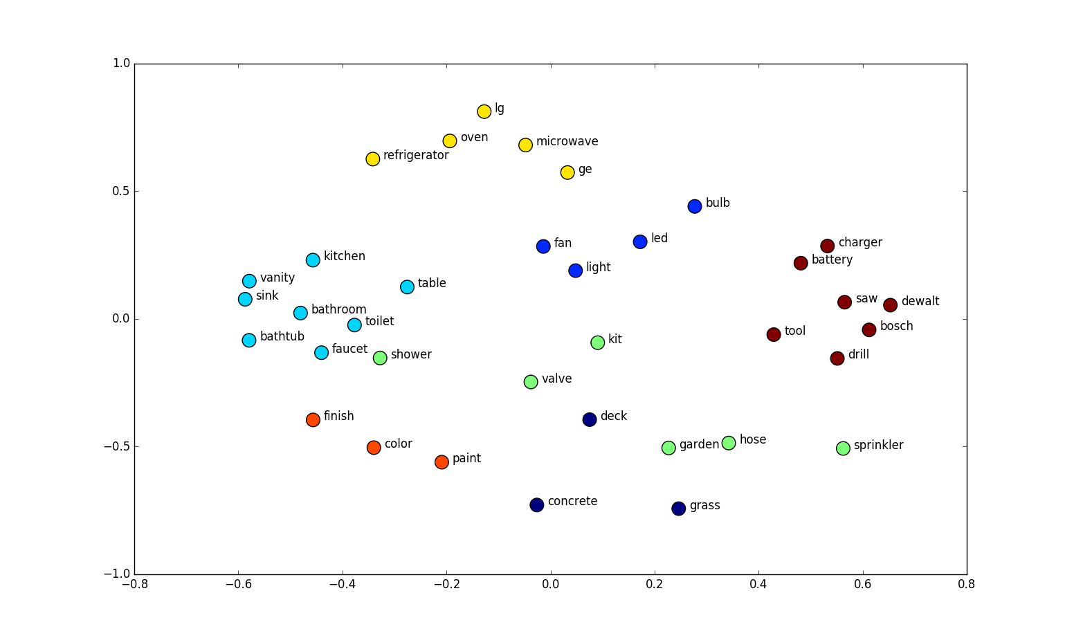
Approach
Tokenization + Embedding
Breaking sequential data into discrete tokens and mapping each token to a vector representation.
Dividing continuous sequences into meaningful, learnable segments.(tokens)
Representing each token or segment as a fixed-dimensional vector in an embedding space.
Modeling
Using embeddings as input to learn patterns and predict outcomes.

Slide 14
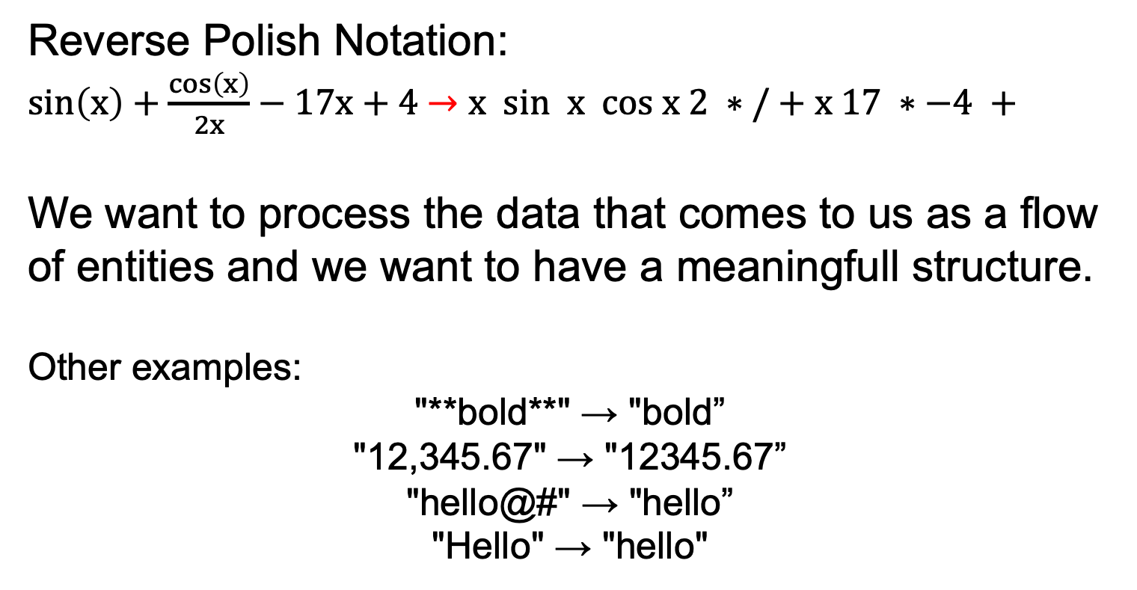
Preprocessing
Reverse Polish Notation:
$\sin\left(x\right)+\frac{\cos\left(x\right)}{2x}−17x+4$ $→x sin x cos x 2 ∗ / + x 17 ∗−4 +$
We want to process the data that comes to us as a flow of entities and we want to have a meaningfull structure.
Other examples:
"**bold**" → "bold”
"12,345.67" → "12345.67”
"hello@#" → "hello”
"Hello" → "hello"

Slide 15
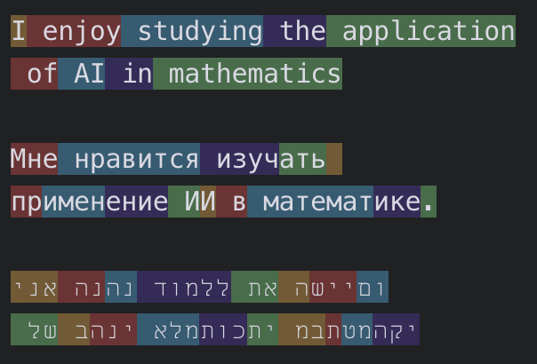
Tokenization
Rule based tokenization
Statistical methods
Word tokenization:
I enjoy studying the application of AI in mathematics.
Letter tokenization:
I enjoy studying the application of AI in mathematics.
Grammar tokenization:
I enjoy studying the application of AI in mathematics.

Slide 16
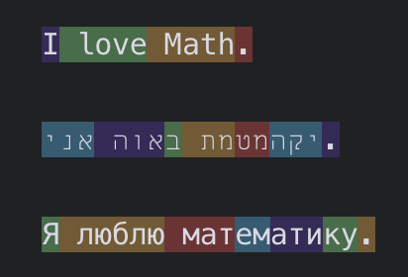
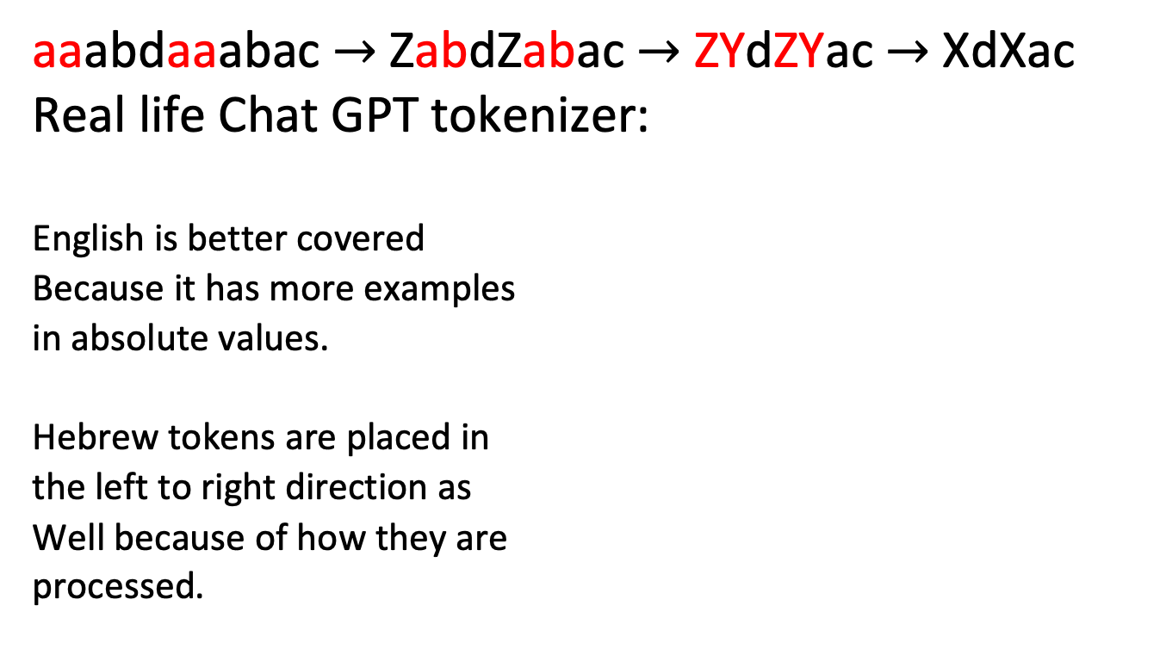
Byte Pair Encoding
aaabdaaabac $→$ ZabdZabac $→$ ZYdZYac $→$ XdXac
Real life Chat GPT tokenizer:
English is better covered
Because it has more examples
in absolute values.
Hebrew tokens are placed in
the left to right direction as
Well because of how they are
processed.

Slide 17

Byte Pair Encoding
Something goes wrong with numbers
Why would we expect it?
Sometimes it can detect morphemes, but generally it can do something strange

Slide 18
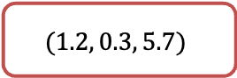
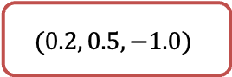
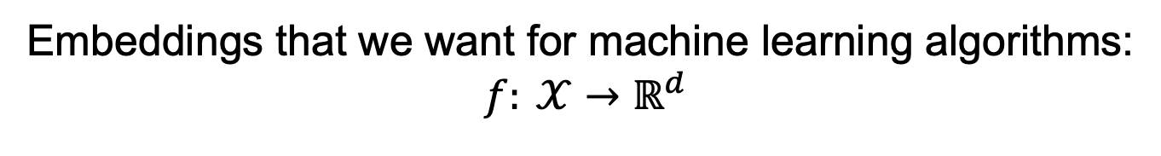
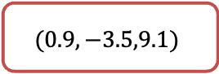
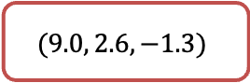
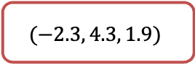
Embeddings
Embeddings that we want for machine learning algorithms:
$$f: 𝒳→ℝ^{d}$$
I
$$(1.2, 0.3, 5.7)$$
Enjoy
$$(−2.3, 4.3, 1.9)$$
Study
$$(9.0, 2.6, −1.3)$$
Math
$$(0.9,−3.5,9.1)$$
.
$$(0.2, 0.5, −1.0)$$

Slide 19
One Hot Encoding
id | token
13 | I
24 | enjoy
35 | syudy
14 | math
5 | .
5 | … | 13 | 14 | … | 24 | … | 35 | …
0 |  | 1 | 0 |  | 0 |  | 0
0 |  | 0 | 0 |  | 1 |  | 0
0 |  | 0 | 0 |  | 0 |  | 1
0 |  | 0 | 1 |  | 0 |  | 0
1 |  | 0 | 0 |  | 0 |  | 0
What can be the problem here?

Slide 20
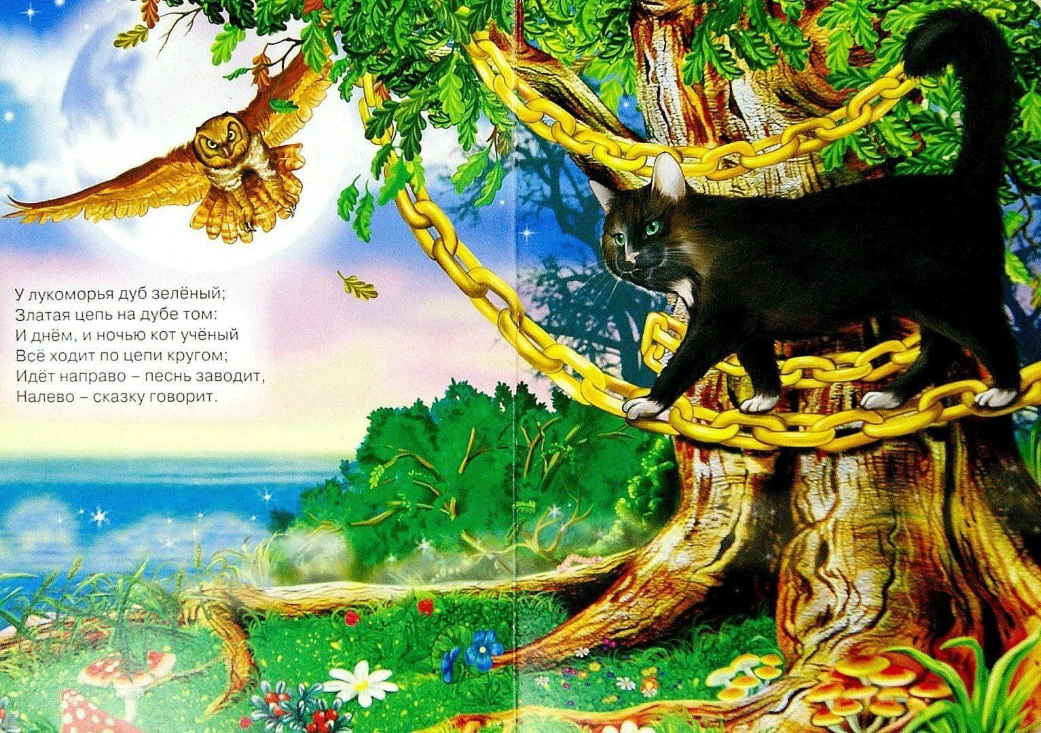
Embeddings

Slide 21
Embedding
У лукоморья дуб зелёный;
Златая цепь на дубе том:
И днём и ночью кот учёный
Всё ходит по цепи кругом;
Идёт направо — песнь заводит,
Налево — сказку говорит.
Chat GPT (Poetic)
Google
Translate
אצל מפרץ, אלון ירוק עומד,
עליו שרשרת זהב מתפתלת;
וביום ובלילה — חתול מדען
סובב על השרשרת בלי הפסקת זמן;
פונה ימינה — שירו מזמר,
פונה שמאלה — סיפור הוא מספר.
יש עץ אלון ירוק ליד לוקומוריה;
שרשרת זהב על עץ האלון ההוא:
החתול הוא אדם מלומד יומם ולילה
הכל מסתובב במעגל;
הוא הולך ימינה ומתחיל לשיר,
משמאל - הוא מספר סיפור.
By the bay a green oak rises high,
A golden chain upon it lies;
And day and night, the Scientist Cat
Paces the chain in a ceaseless track;
When he turns right — he sings a song,
When he turns left — he spins a tale along.
By the seashore there is a green oak;
A golden chain on that oak:
Day and night the learned cat
Walks around the chain;
He goes to the right - he starts a song,
He goes to the left - he tells a story.

Slide 22

Chat GPT generated

Slide 23
Embedding
We would expect (hope):
מדען and מלומד (Scientist and learned) which have a similar meaning would correspond to simillar vectors.
But how do we or model can understand the fact that the words are simillar?
Answer: From a context, right?
I like drinking olut with friends in the bar.
Olut is made of wheat.
You got what olut is by a context and understanding surrounding words.
Let’s see how we can create an embedding which will capture context.

Slide 24
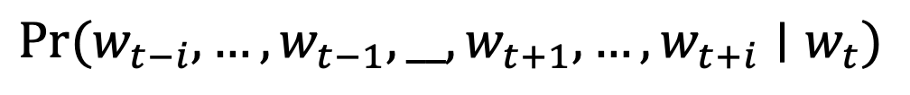
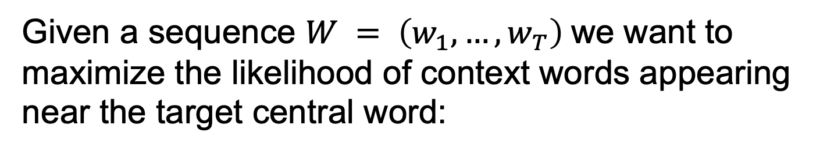
Word2Vec
Learn embeddings by predicting the context words given a target word (Skip-Gram) or vice versa (CBOW).
Given a sequence $W = \left(w_{1}, …, w_{T}\right)$we want to maximize the likelihood of context words appearing near the target central word:
$$\operatorname{Pr}{{(w}_{t−i}, …, w_{t−1}, __, w_{t+1}, …, w_{t+i}∣w_{t})}$$

Slide 25
Word2Vec
And day and night, the Scientist Cat
Paces the chain in a ceaseless track;
And day and night, the Scientist Cat
Paces the chain in a ceaseless track;
And day and night, the Scientist Cat
Paces the chain in a ceaseless track;

Slide 26
Word2Vec
And day and night, the Scientist Cat
Paces the chain in a ceaseless track;
And day and night, the Scientist Cat
Paces the chain in a ceaseless track;
And day and night, the Scientist Cat
Paces the chain in a ceaseless track; <UNK> <UNK> <UNK>

Slide 27
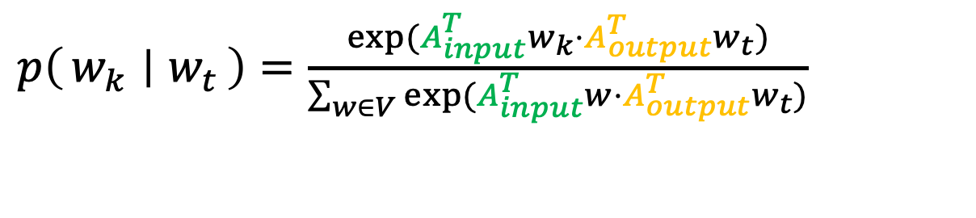
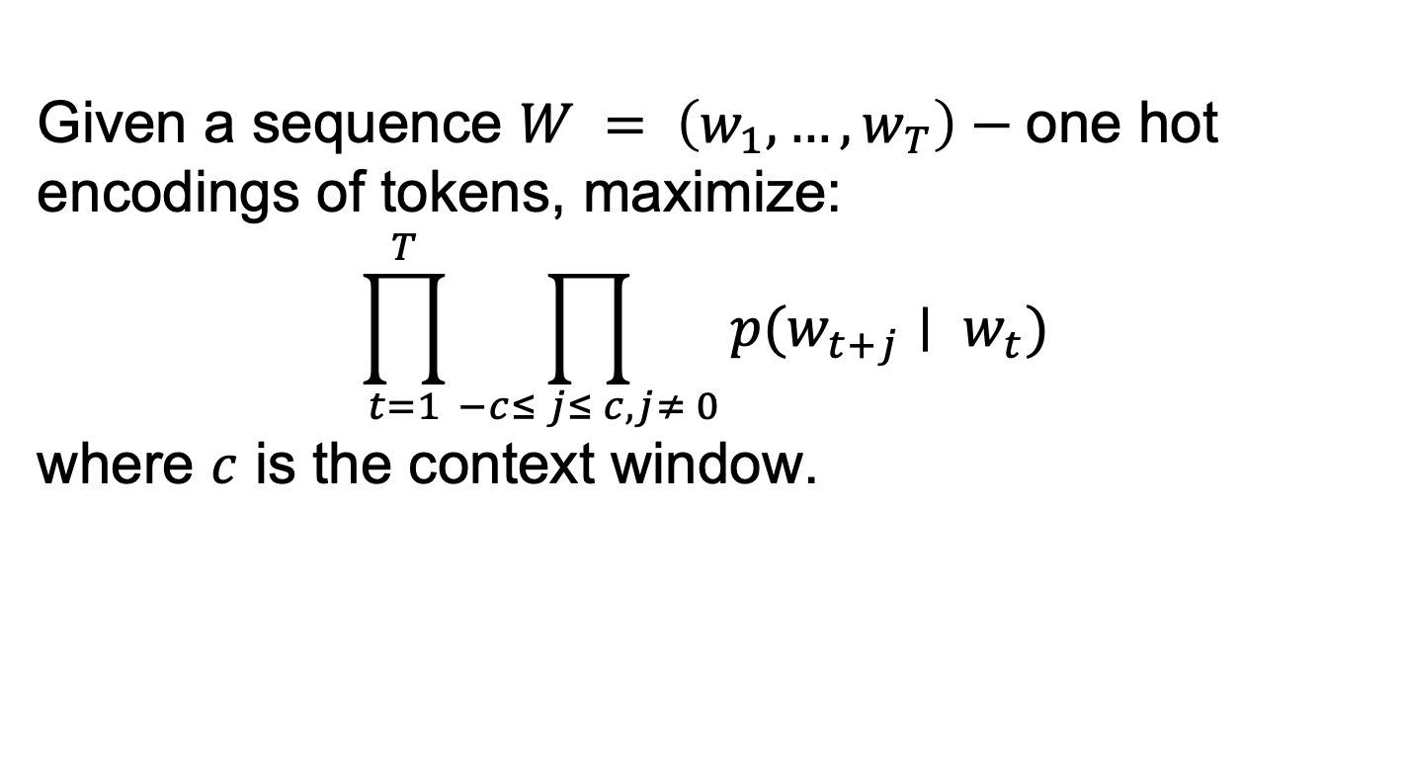
Word2Vec
Learn embeddings by predicting the context words given a target word (Skip-Gram) or vice versa (CBOW).
Given a sequence $W = \left(w_{1}, …, w_{T}\right)−$one hot encodings of tokens, maximize:
$$\prod_{t=1}^{T}{\prod_{−c≤ j≤ c, j≠ 0}{p(w_{t+j}∣ w_{t}) }}$$
where $c$ is the context window.
$p\left(w_{k} ∣ w_{t}\right)=\frac{exp⁡(A_{input}^{T}w_{k}⋅A_{output}^{T}w_{t})}{\sum_{w∈V}{exp⁡(A_{input}^{T}w⋅A_{output}^{T}w_{t})}}$

Slide 28
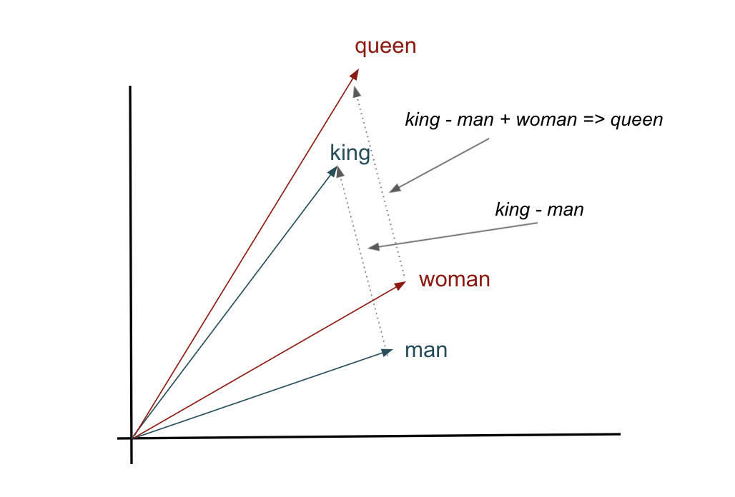
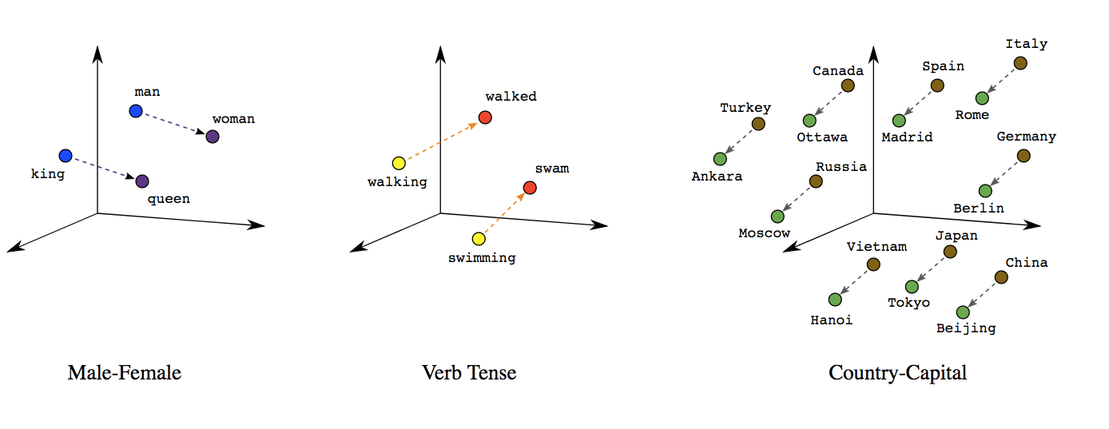
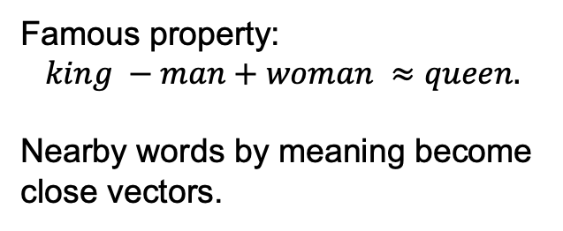
Word2Vec Arithmetics
Famous property:
$$king −man+woman ≈queen.$$
Nearby words by meaning become close vectors.

Slide 29
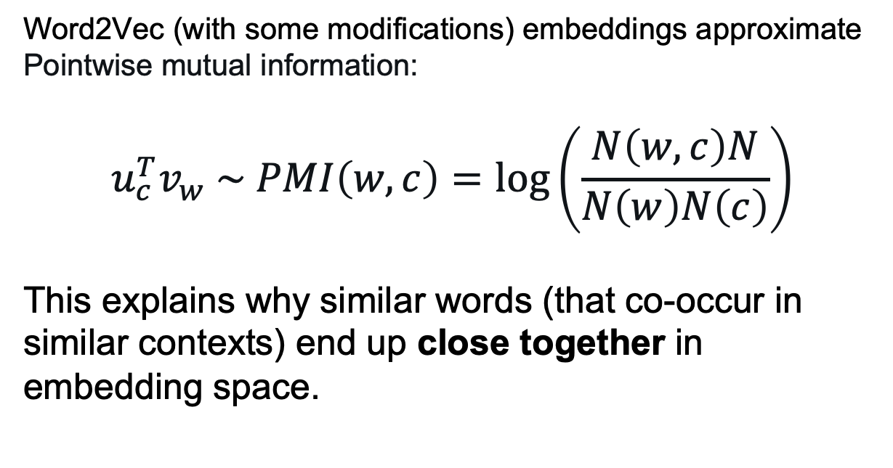
Word2Vec
Word2Vec (with some modifications) embeddings approximate Pointwise mutual information:
$$u_{c}^{T}v_{w} \sim PMI\left(w,c\right)=log\left(\frac{N\left(w, c\right)N}{N\left(w\right)N\left(c\right)}\right)$$
This explains why similar words (that co-occur in similar contexts) end up close together in embedding space.

Slide 30
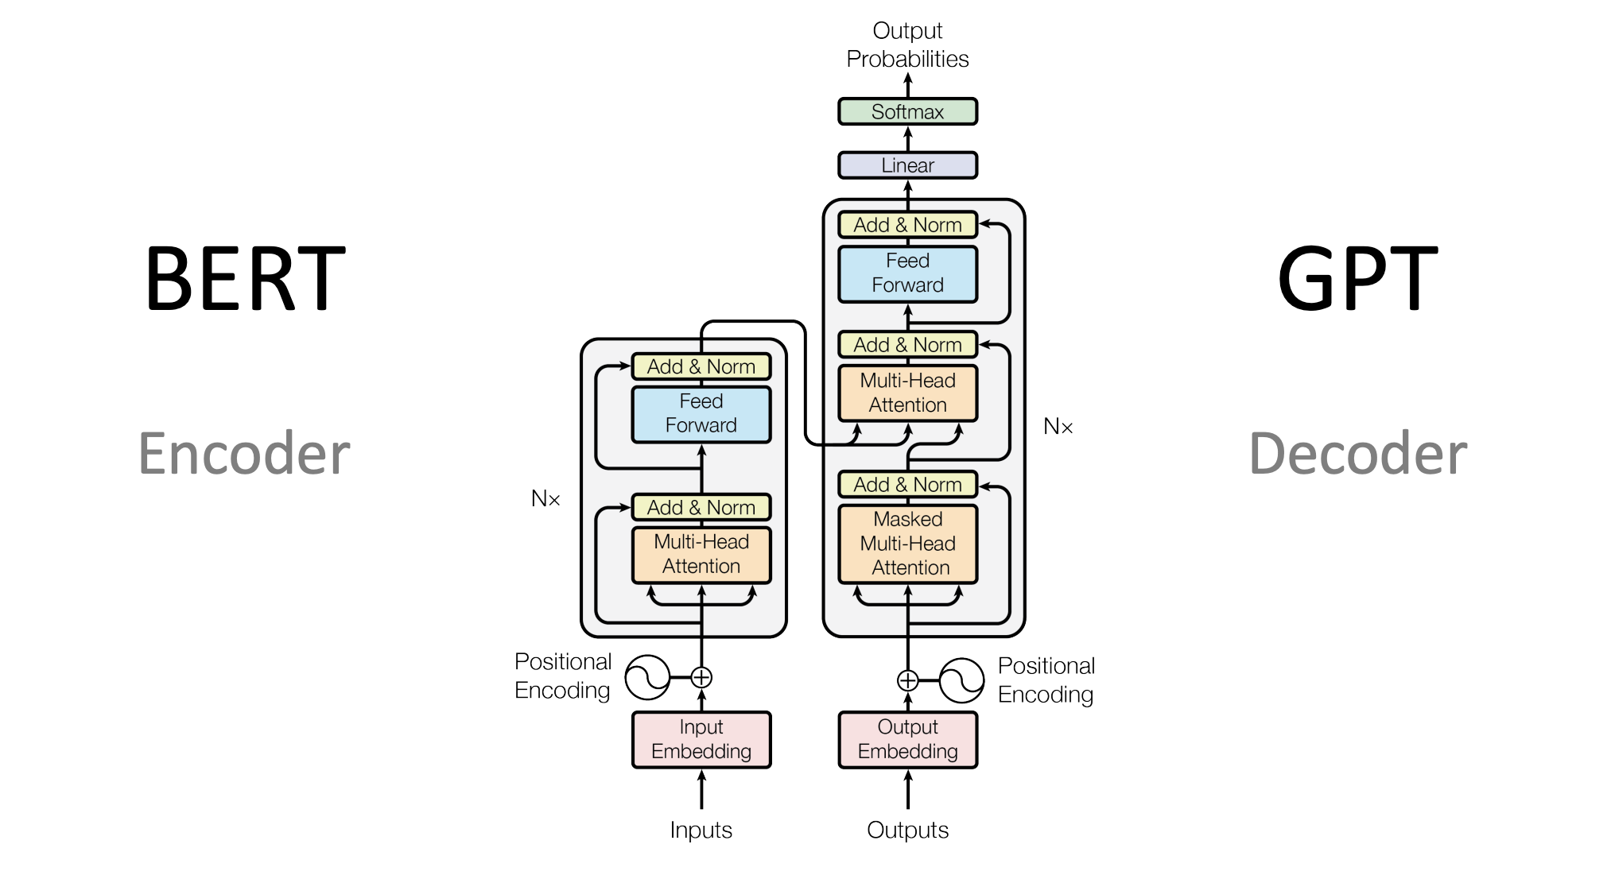
Modeling

Slide 31
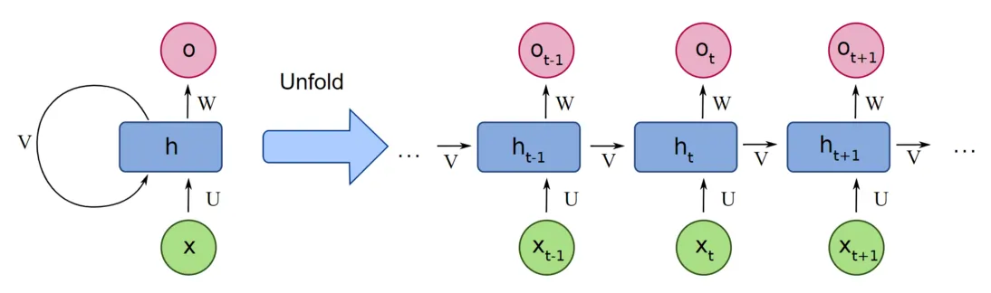
Recurent Neural Network

Slide 32
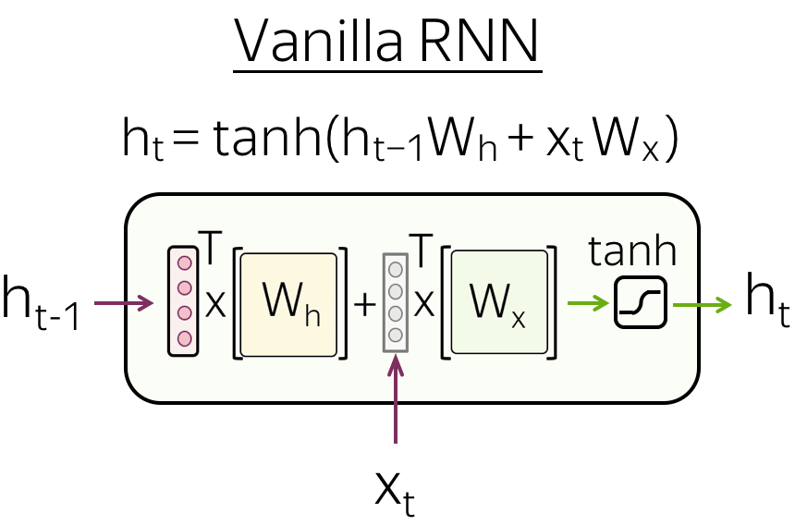
Pictures here and further from NLP Course by Lena Voita

Slide 33
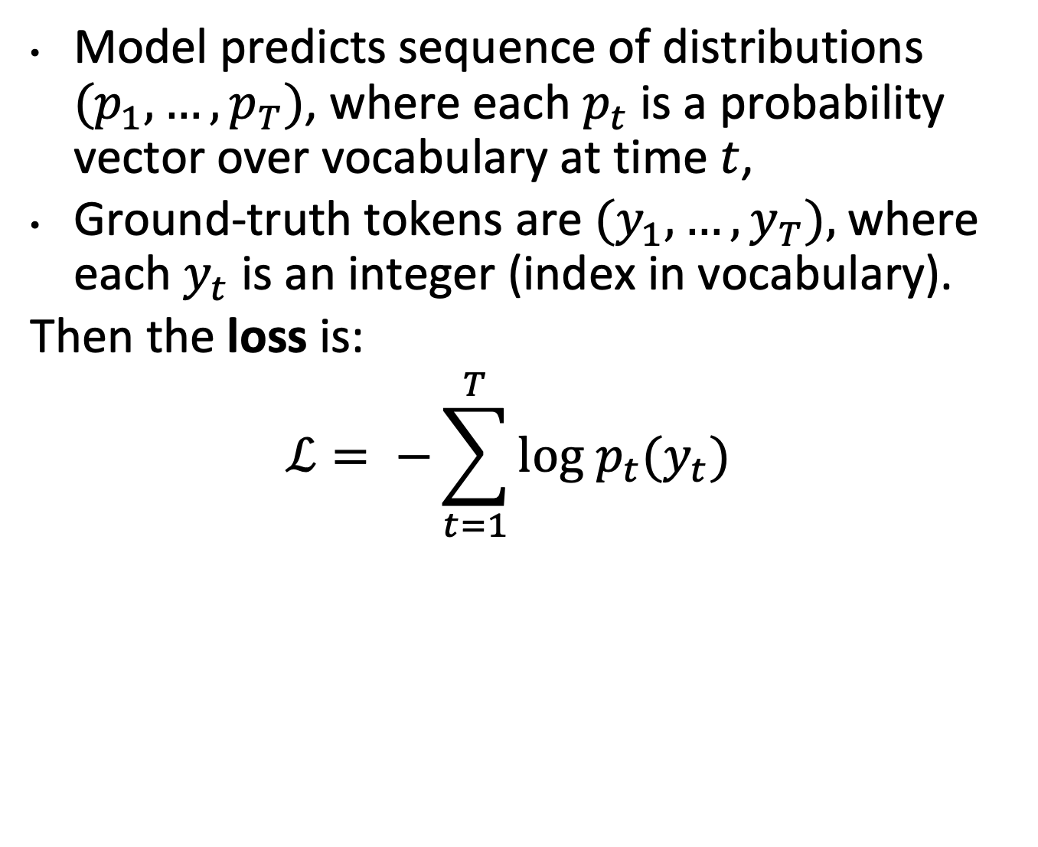
Loss function
Model predicts sequence of distributions $(p_{1}, …, p_{T})$, where each $p_{t}$is a probability vector over vocabulary at time $t$,
Ground-truth tokens are $(y_{1}, …, y_{T}),$where each $y_{t}$ is an integer (index in vocabulary).
Then the loss is:
$$ℒ= −\sum_{t=1}^{T}{log p_{t}(y_{t}) }$$

Slide 34
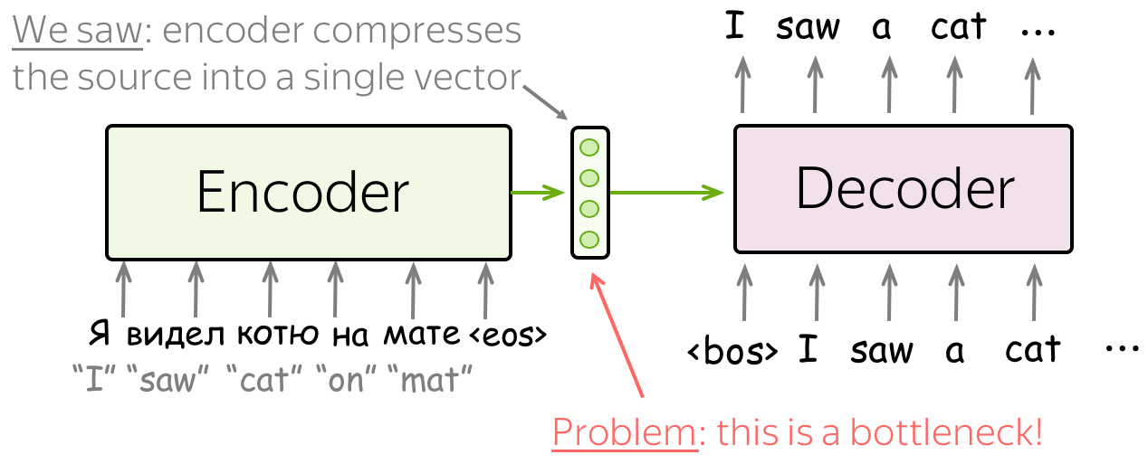
Seq2Seq

Slide 35
Seq2Seq

Slide 36

Seq2Seq
Teacher forcing during train:
We provide ground-truth tokens on a train.

Slide 37
Seq2Seq

Slide 38
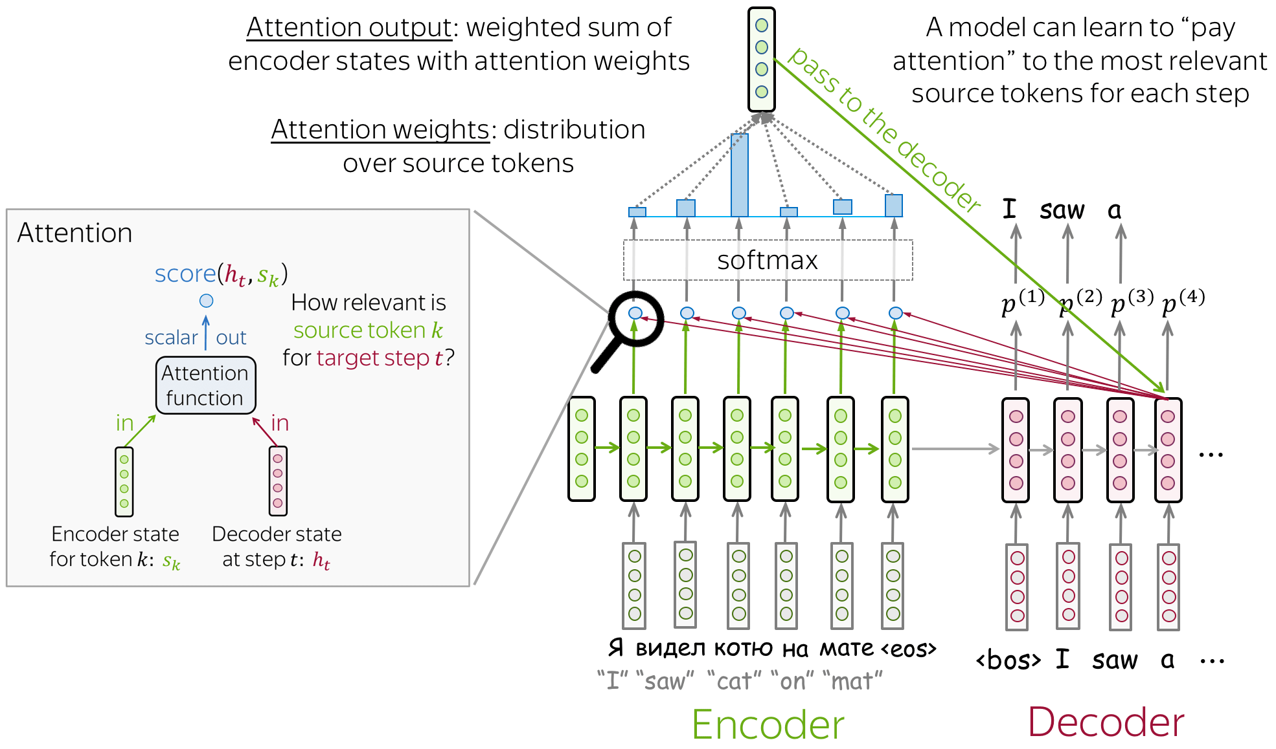
Attention!!!!

